Slide 1
What is happening this week?

Slide 2
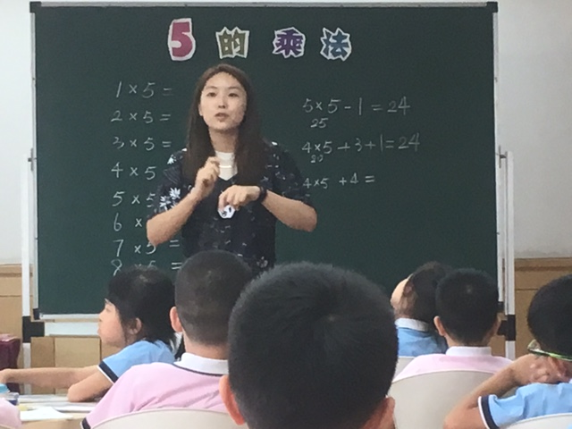
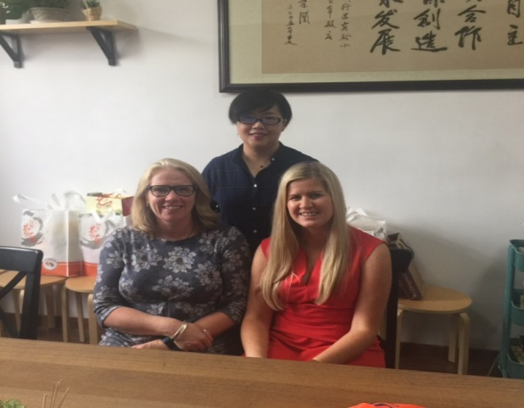
Teachers from Shanghai
Miss Du will be teaching in Class 6
Shanghai Primary School attached to Shanghai Teachers’ Professional College. ( total pupil population of 800)
Ms Xu will be teaching in Class 2
Minhang Experimental Primary School ( total pupil population of 6400!- the largest primary school in Shanghai.)

Slide 3
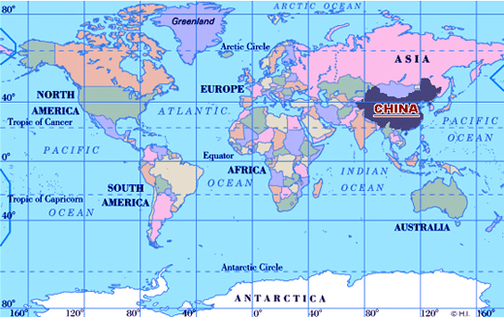
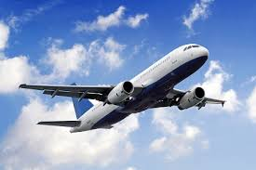
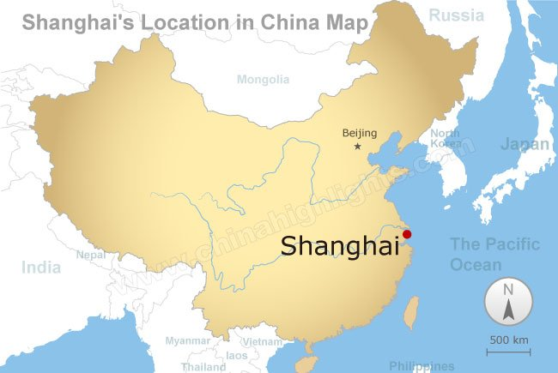
Shanghai: China
12 hours from London to Shanghai ( nearly twice as long as you are in school for the day!!)
Shanghai is the most populous city in China and one of the most populous cities in the world: over 24 miliion people!! ( all of the UK is approximately 65.5 million. Launceston:
8 500!!)

Slide 4
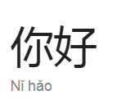
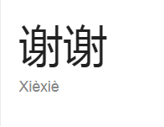
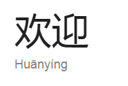
Key Phrases in Mandarin

