Slide 1
Welcome to Class Three

Slide 2
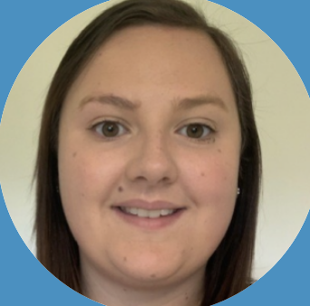
Miss Kempton
Class Teacher
Mrs Duckworth
HLTA

Slide 3
All about me!
I have loved the last year teaching here at St Stephens .Before this I spent two years teaching in Dubai, UAE. It is very hot and sunny there. My last school was surrounded by the desert and you could see camels wandering around outside! Before that I taught in another school in Devon.
I love maths, science and reading.
My favourite place to visit is the beach. I love swimming in the sea and taking my dog for a walk – even when it’s raining!
Miss Kempton
Class Teacher

Slide 4
Class Three
In September you will join Class Three. You will be moving up from Key Stage 1 to Key Stage 2.
It is really important that you bring all of your learning from Class 2 with you when you start Class 3.

Slide 5
What will we be learning?
Morning
Afternoon
English
Theme Learning
Reading
Spelling
Music and Wild Tribe with
Mrs Gilbert
Plymouth Argyle
ARENA Sports
Maths

Slide 6
Expectations
Attendance
Please make sure that you arrives at school no later than 8:55.
Every day at school is important, children need to be in school as much as possible.

Slide 7
Expectations
Snack
In Year 3, children are no longer provided with a fruit snack. Please ensure that your child brings a healthy fruit or veg snack for their morning break.
Drink
Please ensure that your child has a bottle filled with water (not juice).

Slide 8
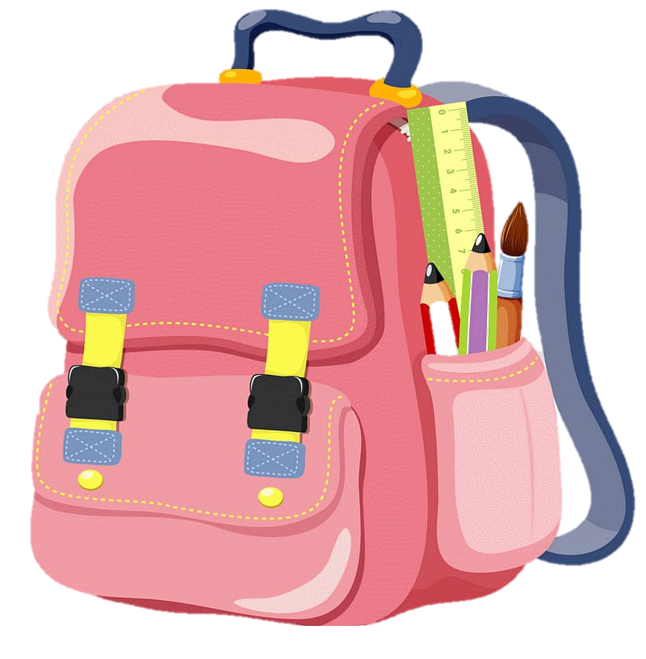
Expectations
You will need these things in school every day:
Correct school uniform (named)
Correct PE kit (named)
Water bottle (named)
Coat
Hat and suncream

Slide 10
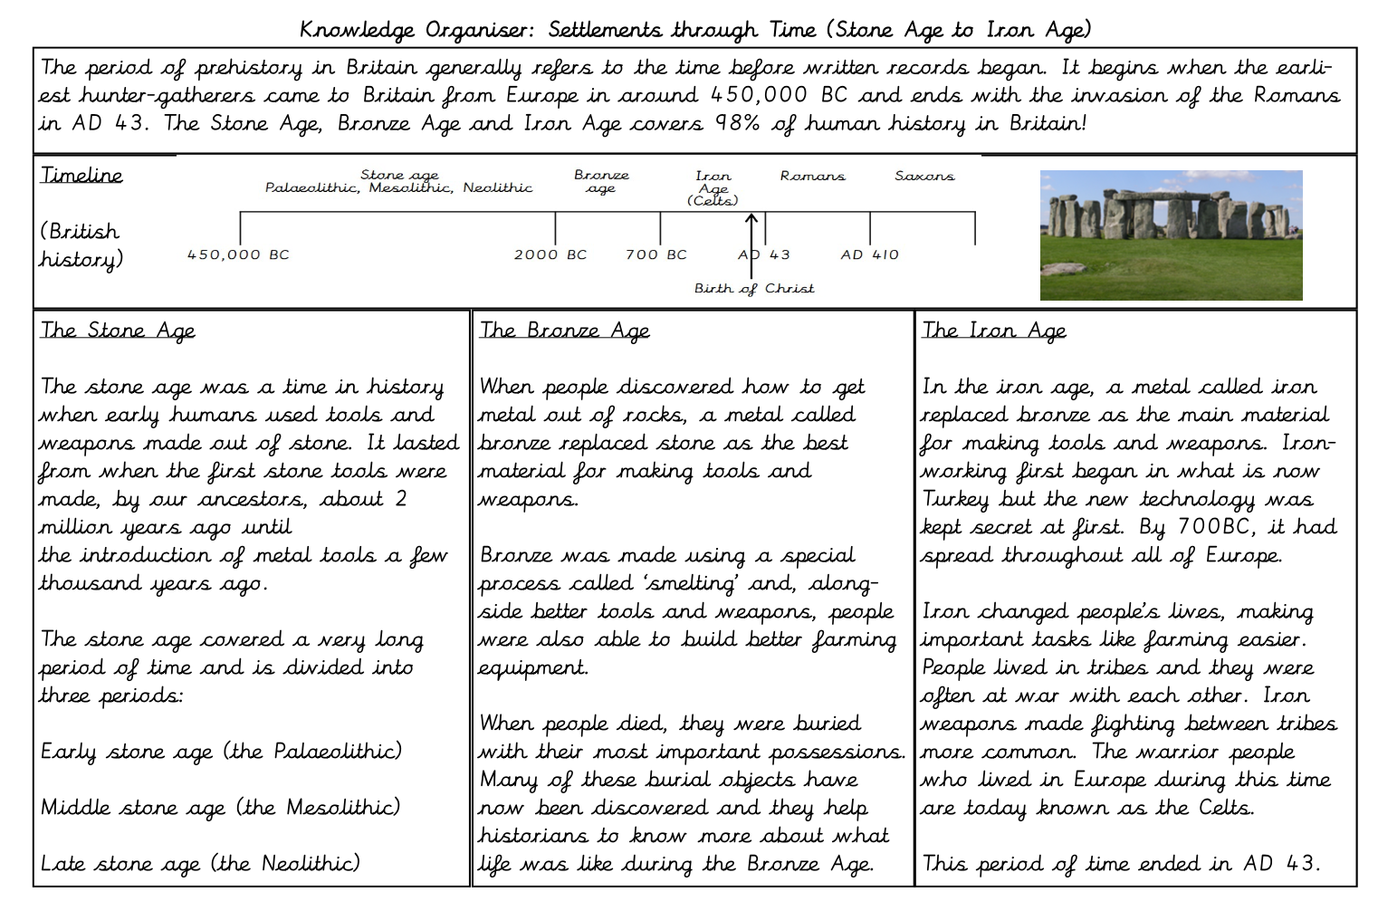
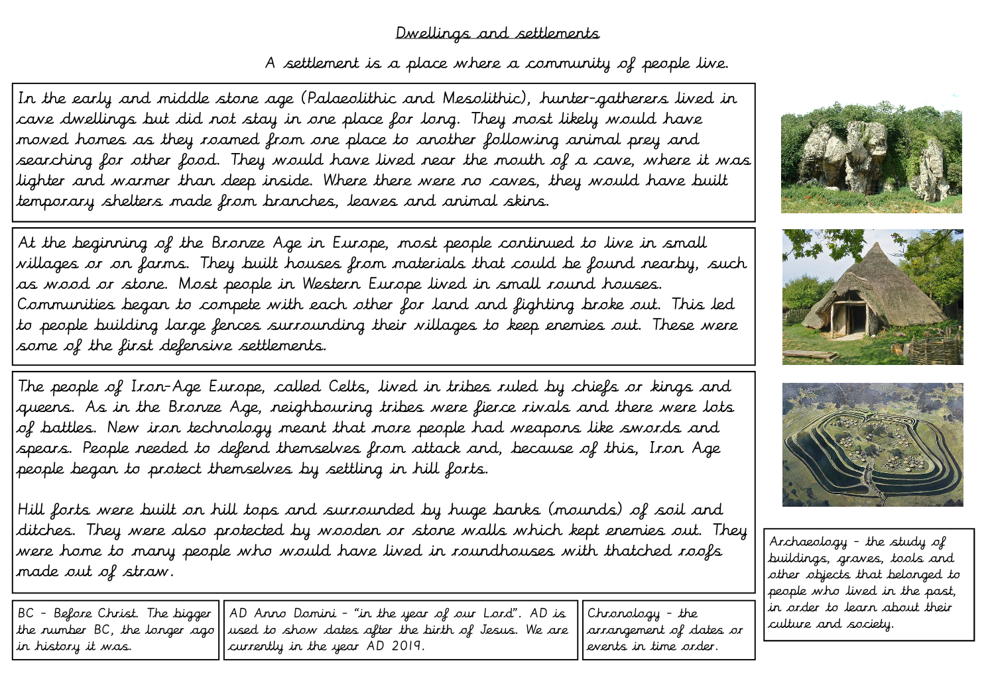
Knowledge Organisers
We we will send a knowledge organiser home for each new theme. It is important that you read this as it will give you lots of ideas about our new theme.

Slide 11
Homework
Homework will be set through the Home Learning Menu. Each week you will need to complete one English or Maths activity and then one piece of Topic homework per theme (one piece every 4-6 weeks).
We also expect every child to read for at least 20 minutes per day and practice their number bonds and times tables regularly.

Slide 12
Home Reading
Accelerated Reader: A Guide for Parents
All children from Year 2-6 take part in the Accelerated Reader programme, which is designed to do the following things:
Find books that are the right level for your child
Encourage your child to read more
Improve your child’s reading ability
It is important that your child should read for
at least 20 minutes everyday.

Slide 13
Getting ‘Year 3’ Ready!
It is really important to keep reading throughout the summer.
Set yourself a challenge!
How many books can you read?

Slide 14
Getting ‘Year 3’ Ready!
Over the summer, if you have any spare time, it is important that you keep practicing your number bonds.
Here are some fun games that you might like to play:
Hit the Button - https://www.topmarks.co.uk/maths-games/hit-the-button
Daily 10- https://www.topmarks.co.uk/maths-games/daily10
Mental Maths Train - https://www.topmarks.co.uk/maths-games/mental-maths-train

Slide 15
I love being part of the
St Stephen’s Community Academy team.
I am so excited to meet you all properly and start our learning journey in September!
Take care, have a wonderful summer and I will see you soon!
Miss Kempton
Class Teacher

