Slide 1
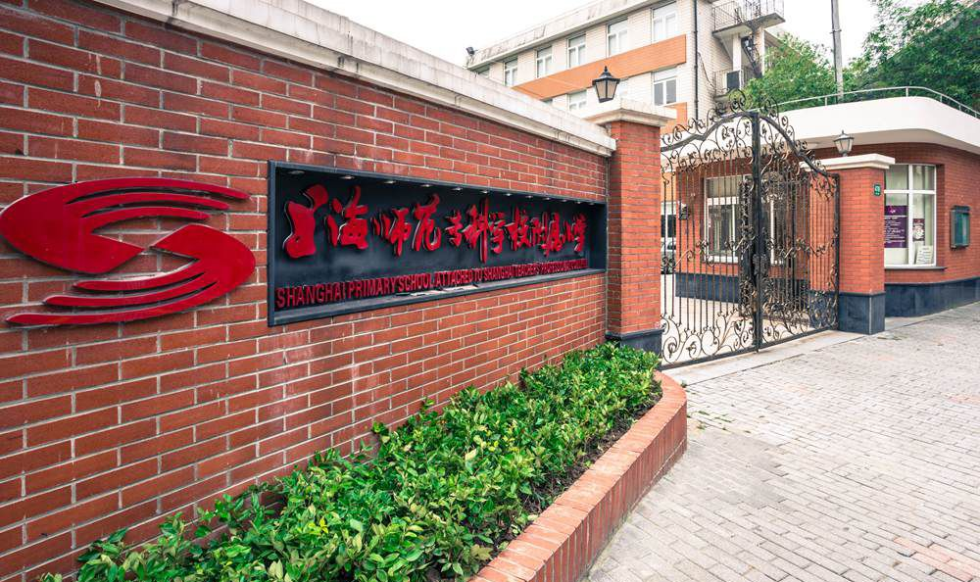
Shirley Du
Shanghai Primary School attached to Shanghai
Teachers' Professional College -----25th Jan. 2018

Slide 2

Review：Calculate
3
4
5
7
Keep the denominator,
add the numerators.
8
8
12
15
=
1
9
3
1
3

Slide 3


Subtraction of fractions
with the same denominator

Slide 4


How far is the little ant away from home?
?
4
5
1
5
4－1
5
－
=
=
1m

Slide 5
Conclusion
4
1
4－1
3
－
＝
＝
5
5
5
5
Substraction of fractions
with a same denominator.
Keep the denominator ,
substract their numerators.

Slide 6
Exercise 1：
_
7
-
4
=
=
9
7
-
_
3
=
=
8
_
=
=
=

Slide 7
Exercise 2：
Calculate directly:
5
6
1
6
4
6
11
25
11
25
11－11
25
0
25
0
－
＝
－
＝
＝
＝
5
1
4
5
2
3
－
=
－
=
12
12
12
7
7
7
minuend
subtrahend

Slide 8


A watermelon was cut into 8 pieces in average, David ate 5 pieces .How many left?
pieces
watermelon
1
—
=
—
=
=
We need the same denominator!

Slide 9
Exercise 3：
How many metre left？
1 metre
We need the same denominator!
9
10
10
10
9
10
10 - 9
10
1
10
1
－
＝
－
＝
＝
m

Slide 10
Calculate directly
3
4
4
4
3
4
4 - 3
4
1
4
1
－
＝
－
＝
＝
4
19
19
19
4
19
19 - 4
19
15
19
1
－
＝
－
＝
＝

Slide 11
11
12
8
12
2
12
11－8－2
1
12
－
－
＝
＝
12
2
12
8
12
1
12
1
12
1
12
1
12
1
12
1
12
1
12
1
12
1
12
1
12
1
12
1
12
11
12
8
12
2
12
11
12
8
12
2
12
11
12
10
12
－
－
（
）
＝
－
＋
＝
－
1
12
＝

Slide 12
Challenge
3
4
2
9
1
4
3
4
2
9
1
4
－
＋
＝
－
＋
4
4
2
9
＝
－
2
9
＝
1
－
9
9
2
9
＝
－
7
9
＝

Slide 13
Challenge
5
8
1
－
( )
－
=
0
1
=
8
8
8
3
5
－
( )
－
=
0
8
8
8

Slide 14
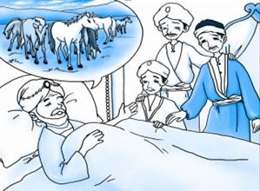
An old man had 11 horses. Before he died, he gave
of the horses to eldest son,
he gave of the horses to second son, he gave of the horses to youngest son.
Story
1
2
1
4
of 12 horses = 6
1
2
of 11 horses = ?
1
6
of 12 horses = 3
1
4
of 11 horses = ?
Smart neighbor said: I will give you one more horse.
of 12 horses = 2
1
6
of 11 horses = ?
11
12
1
2
1
4
1
6
=
＋
＋

Slide 15

What did you learn in this lesson?

