Slide 1
Read Write Inc. Phonics Parents’ Meeting
Notes:
Notes are provided to help you lead the presentation.
Notes in italics are for your attention only.

Slide 2
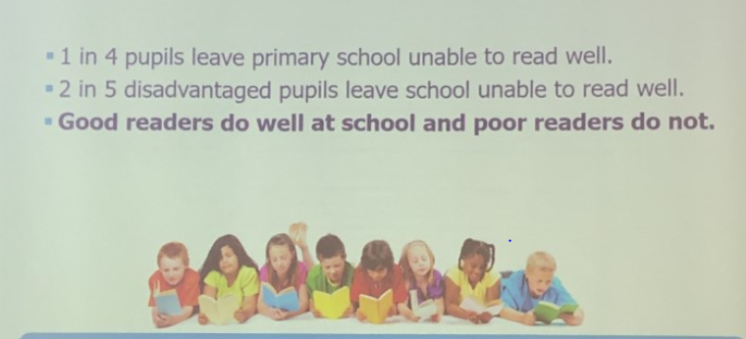

Slide 3
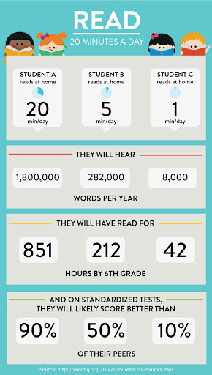

Slide 4
Reminder…
Notes:
Read question.

Slide 5
Sound Pronunciation It is important that we use pure sounds, such as ‘s’ not ‘suh’, so that your child will be able to blend the sounds into words. https://schools.ruthmiskin.com/schools/resources/watch/23/
Notes:
We teach using pure sounds.
We use pure sounds (‘m’ not’ muh’, ’s’ not ‘suh’, etc.) so that your child will be able to blend the sounds into words more easily.
Children need to know sounds – not letter names – to read words.
This video of Sylvie – available on the website – demonstrates how to talk in pure sounds. Play video.

Slide 6
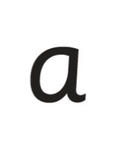
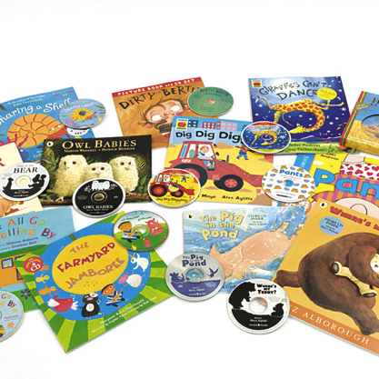
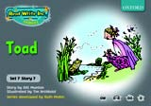
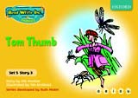
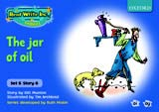
Systematic Approach
sat
mat
p
d
sad
i
t
n
Notes:
Read Write Inc. Phonics is a programme that uses systematic phonics to teach all children to read.
It lasts two years for most children - if they start to learn to read in the Reception class.
(There are some children with learning difficulties who spend longer on the programme.)
Click – We teach the sounds first – in a specific order.
Click – We then teach your children to blend those sounds together in order to read words
Click – The children read words in the matched Storybooks. Each Storybook is carefully matched to the sounds they can already read - setting them up for success.
Click – We read to children ‘real’ books’. Once they have learnt to read, they will be able to independently read these books for themselves.

Slide 7
Simple Speed Sounds
Notes:
Phonics makes learning to read easy for children because we start by teaching them just one way of reading and writing every sound. Here they are on the Simple Speed Sounds chart.
We teach Set 1 sounds first - (sounds as far as a e i o u) and then Set 2 (the shaded sounds ay - oy).
Use MTYT to teach each of the pure sounds to parents.

Slide 8
Speed Sounds Chart
Notes:
We use this Speed Sounds chart in Phonics lessons.
It shows the most common graphemes for each sound.
Each box is a sound box showing different ways to read and write the sound. Demo the ‘f’ sound box with examples of words ‘fun’, ‘huff’, ‘photo’ and the ‘or’ sound box with examples of words ‘or’, ‘door’, ‘more’, ‘dawn’, ‘author’.

Slide 9
Blending Using Fred Talk, Including Fred Talk Games
p
sat
d
mat
i
t
sad
n
Notes:
Once the children know the pure sounds, we teach them to blend sounds to read words. We also teach children to spell the words they learn to read.
We use Fred Talk to help children read and spell words.

Slide 10
Fred Talk
Notes:
This is Fred.
He is a frog who can only speak in sounds, and we call this Fred Talk. For example ‘m’ ‘a’ ‘t’, ‘l’ ‘u’ ‘n’ ‘c’ ‘h’.
He helps children sound out words so they can read and spell.
MTYT some examples with the parents. For example ‘m’ ‘a’ ‘t’ mat, ‘s’ ‘a’ ‘t’ sat.
Click. Fred is our friend!

Slide 11
Storybooks
Notes:
Alongside learning each set of sounds, they read Storybooks that only contain the sounds and words they can read. This sets them up to succeed in their reading.
We discuss and write about the ideas in these Storybooks.
We also teach children to read common exception words – words like ‘said’ and ‘they’.

Slide 12
How does Read Write Inc. teach spelling?
Notes:
Read question.

Slide 13
Fred Fingers
Notes:
We use Fred Fingers to help children sound out words to spell easily.
It means they do not have to memorise lists of spelling words.
It is a tool so they will be able to spell any word.
Demonstrate how to use Fred Fingers.

Slide 14
What should my child read at home?
Notes:
Read question.

Slide 15
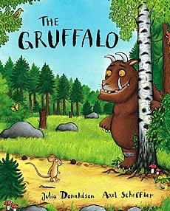
Picture Books And Anything That Interests Them!

Slide 16
Speed Sounds
p
d
i
t
n
Notes:
They will also bring home a picture book to share and enjoy with you at home.
This book has already been read to the class in school so they will care about the story and love hearing the story again and again.

Slide 17
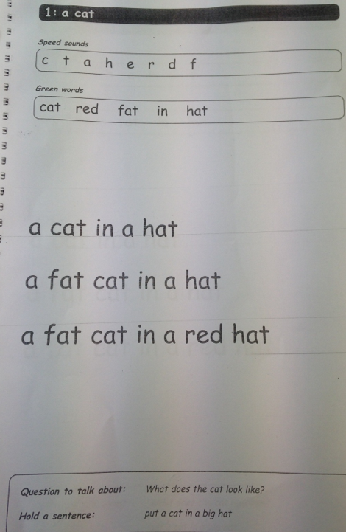
Ditty Photcopiable Masters
Notes:
They will also bring home a picture book to share and enjoy with you at home.
This book has already been read to the class in school so they will care about the story and love hearing the story again and again.

Slide 18
Ditty Books
These books offer early practice in reading short decodable passages that form an important bridge between reading single words and whole sentences.
Notes:
They will also bring home a picture book to share and enjoy with you at home.
This book has already been read to the class in school so they will care about the story and love hearing the story again and again.

Slide 19
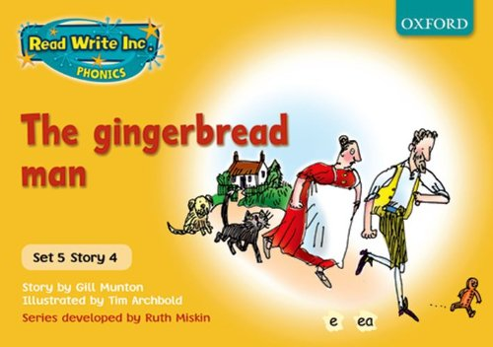
Story Books
These books storybooks provide structured practice in decoding words and reading through phonics. Each book is carefully graded so that children can read them with confidence, as soon as they have learned the sounds linked to the set.

Slide 20
Story Books
Book Bag Books are engaging texts to support children with additional reading practice outside the classroom. They have been specifically designed for children to take home after school, in order to share their reading journey and celebrate their achievements with parents and carers

Slide 21
How can I help at home?
Notes:
Read question.

Slide 22
Storytime
Read with your children
Read to your children
Ask lots of questions and share opinions
You're never too old, too wacky, too wild, to pick up a book and read to a child.
Dr Seuss
Notes:
One of the most important things you can do as a parent at home is read higher level texts to your child.
This helps develop an enjoyment for stories and the motivation for learning to read themselves.
Ask questions and share opinions about what you read to engage them in discussion, get them thinking about what they read and develop vocabulary.
Click and read.

Slide 23
Support How Your Child Is Learning To Read And Spell In School
Pure sounds
Fred Talk
Fred Fingers
Lots of talking!
Notes:
It really helps to be aware of how your child is learning in the classroom – pure sounds not letter names; Fred Talk when they are reading words and Fred Fingers when they are spelling words.
Encourage your child to discuss their Phonics lessons with you and to read and discuss their storybook with you at home.
We have shared the basics of Read Write Inc. Phonics and how you can help.
There are also some online resources that you can access for free. Click through to next slide.

Slide 24
Online resources available
Ruth Miskin Parents’ Page:
http://www.ruthmiskin.com/en/parents/
Free e-books for home reading:
http://www.oxfordowl.co.uk/Reading/

Slide 25
The Simple View of Reading
Notes:
We teach using pure sounds.
We use pure sounds (‘m’ not’ muh’, ’s’ not ‘suh’, etc.) so that your child will be able to blend the sounds into words more easily.
Children need to know sounds – not letter names – to read words.
This video of Sylvie – available on the website – demonstrates how to talk in pure sounds. Play video.

Slide 26
Any other questions

