Slide 1
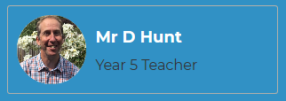

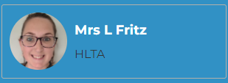
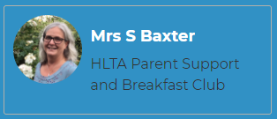
Welcome to Class 5
Mr. Hunt, Mrs. Fritz and Mrs. Baxter.
Notes:
Roles within the class

Slide 2
Expectations
Correct school uniform (named)
Water bottle (water and not juice, named)
Coat
Hat/Suncream in warm weather
Attendance
Children need to be in school by 8:55am each day.
Year 5 door opens at 8:45am
In Year 5 the children leave school at 3:15pm.
It is paramount that children are in school as much as possible. As a school our attendance target is 95%.
Notes:
Aim for all to achieve to the best of their ability

Slide 3
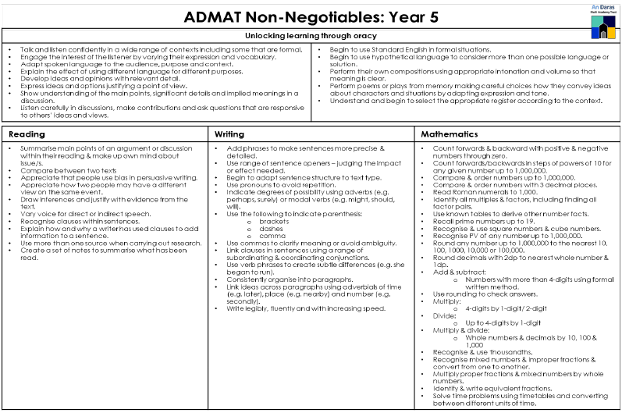
Information for parents and carers on the end of year expectations for children in our school. The staff have identified these expectations as being the minimum requirements your child must meet in order to ensure continued progress throughout the following year. All the objectives will be worked on throughout the year and will be the focus of direct teaching. Any extra support you can provide in helping your children to achieve these is greatly valued.
Notes:
Aim for all to achieve to the best of their ability

Slide 4
Home learning
We provide home learning books for all children to keep their home learning in a collection together. Home learning is set on a Friday and needs to be handed in on a Wednesday
Reading (daily)
Spelling: Children are given the list of common exception words for Year 5/6. Children can be encouraged to practice these at home.
Children are set home learning each Friday. The home learning in Year 5 is English and Maths from their class learning. The home learning includes Maths homework using children’s own ‘My Maths’ and English CGP books.
Homework club is available for children who cannot access MyMaths at home or who prefer to do homework at school.
( Children will be provided with their login in September for My Maths and Times Table Rockstars, however it will be the same as Year 4)

Slide 5
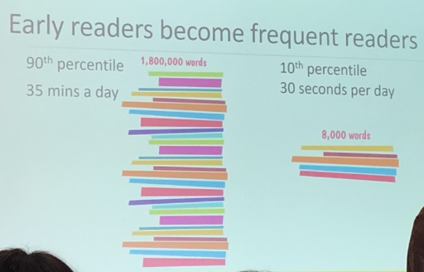
Home Reading

Slide 6
Home Reading
Accelerated Reader: A Guide for Parents
From Year 2 -6, all children take part in the Accelerated Reader programme, which is designed to do the following things:
Find books that are the right level for your child
Encourage your child to read more
Improve your child’s reading ability.
https://educationendowmentfoundation.org.uk/projects-and-evaluation/projects/accelerated-reader/#closeSignup

Slide 7
Home Reading
“How much should my child read each day?”
According to Renaissance Learning’s research, children who read at least 20 minutes a day with a 90% comprehension rate on AR quizzes see the greatest gains.
Therefore, your child should have at least 20 minutes set aside for reading during day.

Slide 8
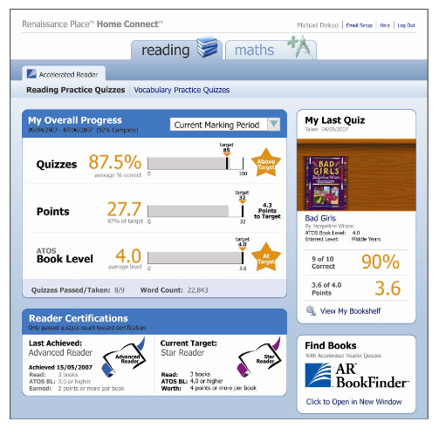
Home Reading
How will I know how my child is doing?
You can access your child’s AR information in Renaissance Place Home Connect from any web-enabled computer.
You can only access information about your own child.
You can also access AR BookFinder to search for titles of interest.
Once in the programme, you can view your child’s progress towards targets, points and books read.

Slide 9
KS2 SATs
At the end of Year 6, children will take National Statutory Assessments (SAT’s) in:
Reading
Grammar and Punctuation
Spelling
Maths
All assessment are due to take place in May.
Most of the ground work for the KS2 SAT’s is in Year 5 as they will only have two terms in Year 6 before the testing.
Notes:
Discuss preparation and support with this- in September will provide a parent guide to SATs for Reading and Maths

Slide 10
Wild Tribe/Outdoor Learning
What the children wear is important and will vary according to the time of year. The children must wear:
• long trousers
• long sleeved tops/jumpers
• have a waterproof coat
• wellington boots
You may like to send in waterproof trousers or all in one wet weather gear but this is not essential.
Please be aware that these clothes are likely to get dirty and wet at times so don't send any ‘best’ clothes.
Notes:
Discuss preparation and support with this- in September will provide a parent guide to SATs for Reading and Maths

Slide 11

Communication
Letters home- spares can be collected from
the office.
Texts
Website: check for key dates and upcoming events
Twitter Feed
Newsletter emailed out- this also contains key information.
Please make appointments at reception if you would like to see your child’s teacher.
Please ensure that contact details and medical details are up to date.

Slide 12
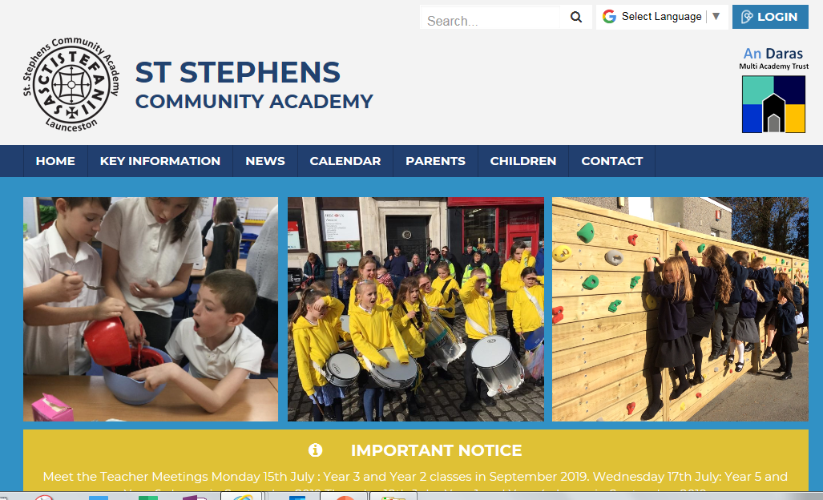

Photos
Please look at our school website and Twitter throughout the year.

