Slide 1

Welcome to Class 4
Mrs Hunt, Miss Callcut,
Mrs Grimes and Mr Houghton
Notes:
Roles within the class

Slide 2
Staff
Mrs Hunt (Class Teacher Tuesday-Friday)
Miss Callcut (Class Teacher - Mondays)
Mrs Grime (LSA – every morning)
Mr Houghton (LSA – every morning)

Slide 3
Expectations
Correct school uniform (named)
Correct PE kit (named)
Water bottle (water and not juice, named)
Coat
Hat/Suncream in warm weather
Attendance
Children need to be in school at 8:40am each day.
The day finishes at 3:15.
It is paramount that children are in school as much as possible. As a school our attendance target is 96%.
Notes:
Aim for all to achieve to the best of their ability

Slide 4
Wild Tribe/Outdoor Learning
Long trousers
Long sleeved top/jumpers
Waterproof coat
Wellies
Can provide waterproof trousers
These clothes are likely to get dirty so please don’t send in ‘best’ clothes.
Notes:
Aim for all to achieve to the best of their ability

Slide 5
Year 4 – Expectations
Reading: Accelerated Reader
Spelling: Year 3 / 4 words
Writing
Maths: main focus will be multiplication please encourage regular practice over the holidays
Notes:
Expectations of presentation- completion of tasks

Slide 6
Homework
Maths, English and Theme Homework will be sent out every term. Children will choose either an English or Maths to do each week and one Theme for the term.
Homework is due in Wednesday each week.
Reading (Accelerated Reader books)
Spelling list of Year 3/4 words will be set out with homework books at the start of the year.

Slide 7
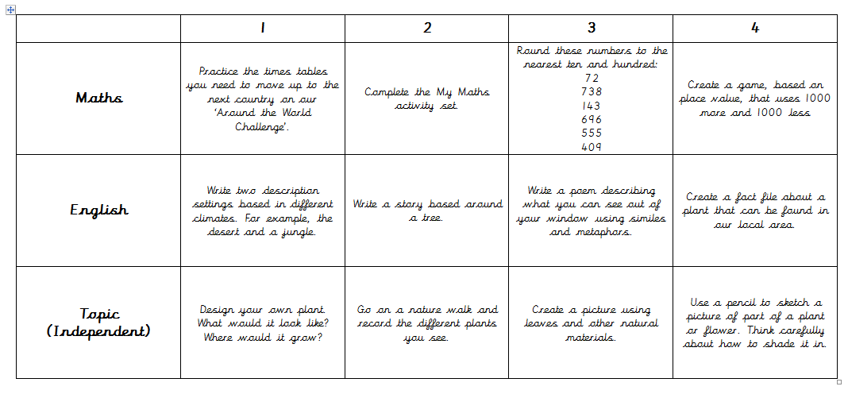
Home Learning Grid - Example

Slide 8
Home Reading
Accelerated Reader: A Guide for Parents
From Year 2 -6, all children take part in the Accelerated Reader programme, which is designed to do the following things:
Find books that are the right level for your child
Encourage your child to read more
Improve your child’s reading ability.
https://educationendowmentfoundation.org.uk/projects-and-evaluation/projects/accelerated-reader/#closeSignup

Slide 9
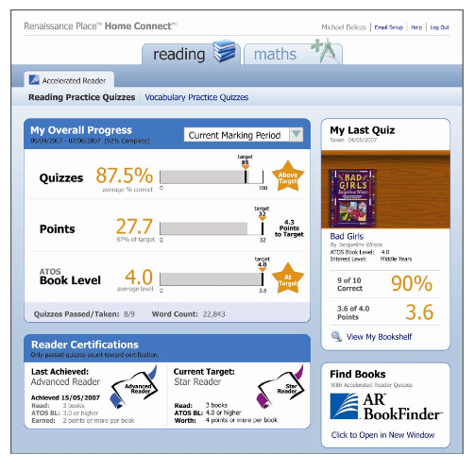
Home Reading
How will I know how my child is doing?
You can access your child’s AR information in Renaissance Place Home Connect from any web-enabled computer.
You can only access information about your own child.
You can also access AR BookFinder to search for titles of interest.
Once in the programme, you can view your child’s progress towards targets, points and books read.

Slide 10
Home Reading
“How much should my child read each day?”
According to Renaissance Learning’s research, children who read at least 20 minutes a day with a 90% comprehension rate on AR quizzes see the greatest gains.
Therefore, your child should have at least 20 minutes set aside for reading during day.

Slide 11
Year 4 Themes
How and why is my local area changing?
How do artefacts help us understand the lives of people in Iron Age Britain?
How did the arrival of the Romans change Britain?
Why do some earthquakes cause more destruction than others?
How did a pile of dragon bones help to solve an ancient Chinese mystery?
Why are jungles so wet and deserts so dry?

Slide 12

Communication
Letters /emails
Texts
Website: check for key dates and upcoming events
Facebook
Newsletter emailed out- this also contains key information.
Please make appointments at reception if you would like to see your child’s teacher.
Please ensure that contact details and medical details are up to date.

Slide 13
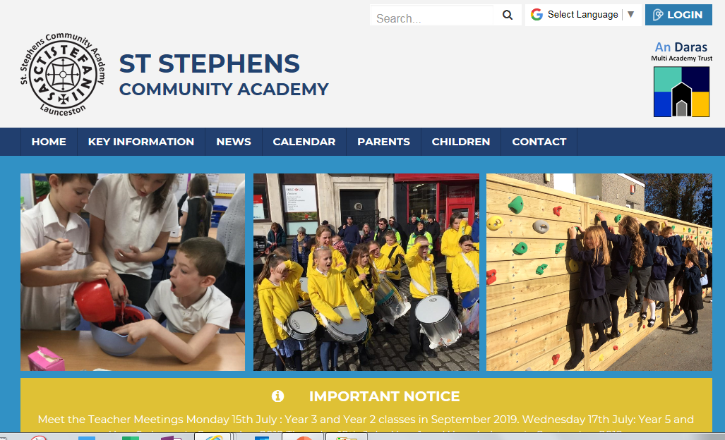
Photos
Please look at our school website and Facebook throughout the year.
https://www.ststephenscornwall.co.uk/web

Slide 14
Any Questions?

